Slide 1
COMPARATIVE STUDY OF IMAGE COMPRESSION TECHNIQUES
Monisha Bajaj 38
Sasha Jawahiry 135
Lavina Sabhnani 136

Slide 2
Abstract
The development and demand of multimedia products has been growing increasingly fast. This contributes to insufficient storage in memory devices.
In Computer Science and Information Technology, Image Compression is an application of data compression that encodes an image within fewer bits than the original image.
The main goal of such system is to reduce the storage quantity optimally, and the decoded image displayed on the monitor must be as similar to the original image as possible.
Here, we briefly compare the different fundamental - primitive theories of image compression on the basis of certain parameters.

Slide 3
Problem Definition
The principal definition for Image Compression is the reduction of the amount of image data (bits) while preserving information (important image details).
This technology is a key enabling factor in many imaging and multimedia concepts.
The reduction in file size allows more images to be stored in a given amount of disk or memory space.
It also reduces the time required for images to be sent over the Internet or downloaded from Web pages.

Slide 4
Scope of the Project
Large images can be studied.
For example:
·MRI's, medical ultrasound view.
·Materials micro-structures with many attributes at a given grid point.
Content-based retrieval from large databases.
Need fast search and retrieval and fast scalable decoding for browsing, retrieval, and transmission.
Contribution is to limit degradation the least possible.

Slide 5
Proposed System
There are five types of methods which are compared namely:
1. Discrete Cosine Transform (DCT).
2. Discrete Cosine Transform with Low Pass Filtering (DCT+LPF).
3. Discrete Wavelet Transform (DWT).
4. Discrete Wavelet Transform with Low Pass Filtering on LL region (DWT+LPF).
5. Single Value Decomposition (SVD).

Slide 6
1.Discrete Cosine Transform (DCT)
A discrete cosine transform (DCT) expresses a finite sequence of data points in terms of a sum of cosine functions oscillating at different frequencies.
The use of cosine rather than sine functions is critical for compression, since it turns out that fewer cosine functions are needed to approximate a typical signal, whereas for differential equations the cosines express a particular choice of boundary conditions.
In particular, a DCT is a Fourier-related transform similar to the discrete Fourier transform (DFT), but using only real numbers.
The DCTs are generally related to Fourier Series coefficients of a periodically and symmetrically extended sequence whereas DFTs are related to Fourier Series coefficients of a periodically extended sequence.

Slide 7
2. Discrete Cosine Transform with Low Pass Filtering(DCT+LPF)
This method applies low pass filtering on the DCT image.
A low-pass filter is a filter that passes signals with a frequency lower than a certain cutoff frequency and attenuates signals with frequencies high
Low-pass filters is used in audio, anti-aliasing filters for conditioning signals prior to analog-to-digital conversion, digital filters for smoothing sets of data, acoustic barriers, blurring of images, and so on. er than the cutoff frequency.

Slide 8
3. Discrete Wavelet Transform (DWT)
In numerical analysis and functional analysis, a discrete wavelet transform (DWT) is any wavelet transform for which the wavelets are discretely sampled.
As with other wavelet transforms, a key advantage it has over Fourier transforms is temporal resolution: it captures both frequency and location information.
Haar : The first DWT was invented by Hungarian mathematician Alfréd Haar. For an input represented by a list of 2^{n}{\displaystyle 2^{n}}2 numbers, the Haar wavelet transform may be considered to pair up input values, storing the difference and passing the sum. This process is repeated recursively, pairing up the sums to prove the next scale, which leads to {\displaystyle 2^{n}-1}2^{n}-1 differences and a final sum. We will be using this method on the original image to apply DWT compression for comparison purposes.

Slide 9
4. Discrete Wavelet Transform with Low Pass Filtering (DWT+LPF)
This method applies low pass filtering on the DWT image.
A low-pass filter is a filter that passes signals with a frequency lower than a certain cutoff frequency and attenuates signals with frequencies high
Low-pass filters is used in audio, anti-aliasing filters for conditioning signals prior to analog-to-digital conversion, digital filters for smoothing sets of data, acoustic barriers, blurring of images, and so on. er than the cutoff frequency.

Slide 10
5. Single Value Decomposition (SVD)
In linear algebra, the singular value decomposition (SVD) is a factorization of a real or complex matrix. It is the generalization of the Eigen decomposition of a positive semi definite normal matrix (for example, a symmetric matrix with positive Eigen values) to any {\displaystyle m\times n}m x n matrix via an extension of polar decomposition.
Applications that employ the SVD include computing the pseudo inverse, least squares fitting of data, multivariable control, matrix approximation, and determining the rank, range and null space of a matrix.

Slide 11
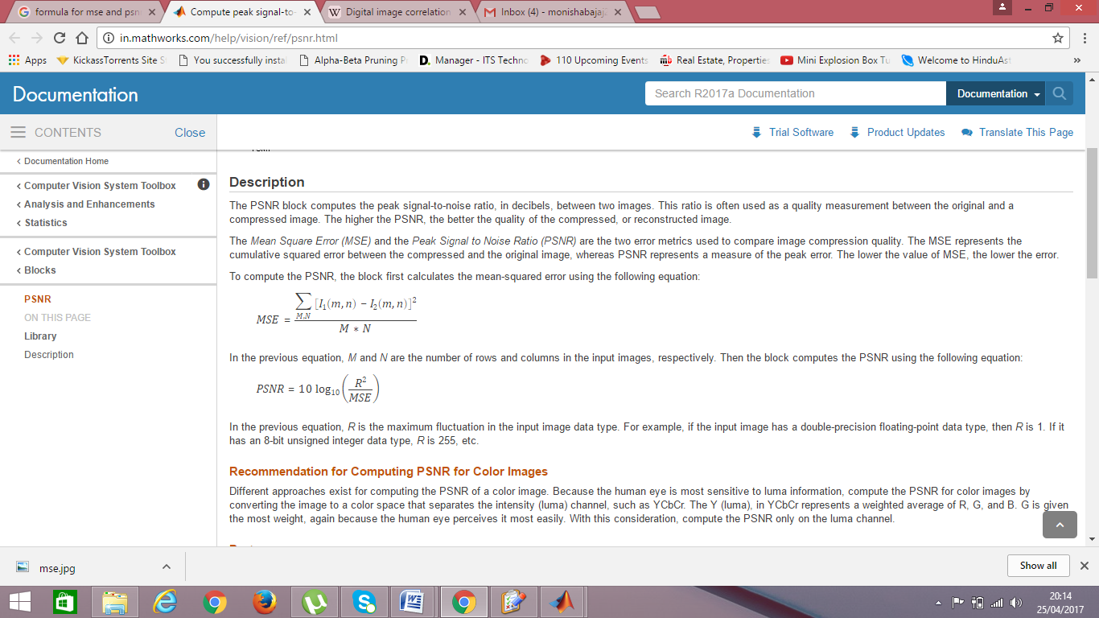
Parameters
1. Mean Squared Error (MSE):
In statistics, the mean squared error (MSE) or mean squared deviation (MSD) of an estimator (of a procedure for estimating an unobserved quantity) measures the average of the squares of the errors or deviations—that is, the difference between the estimator and what is estimated. MSE is a risk function, corresponding to the expected value of the squared error loss or quadratic loss. The difference occurs because of randomness or because the estimator doesn't account for information that could produce a more accurate estimate.

Slide 12
Parameters
2. Root Mean Squared Error (RMSE):
The root-mean-square error (RMSE) is a frequently used measure of the differences between values (sample and population values) predicted by a model or an estimator and the values actually observed. The RMSD represents the sample standard deviation of the differences between predicted values and observed values. RMSD is a good measure of accuracy, but only to compare forecasting errors of different models for a particular variable and not between variables, as it is scale-dependent.
Formula: RMSE= sqrt(MSE)

Slide 13
Parameters
3. Compression Ratio (CR):
Data compression ratio, also known as compression power, is a computer science term used to quantify the reduction in data-representation size produced by a data compression algorithm. The data compression ratio is analogous to the physical compression ratio used to measure physical compression of substances.

Slide 14
Parameters
4. Signal-to-Noise Ratio (SNR):
The signal-to-noise ratio (SNR) is used in imaging as a physical measure of the sensitivity of a (digital or film) imaging system. Industry standards measure SNR in decibels (dB) of power and therefore apply the 10 log rule to the "pure" SNR ratio. In turn, yielding the "sensitivity". Industry standards measure and define sensitivity in terms of the ISO film speed equivalent; SNR:32.04 dB = excellent image quality and SNR:20 dB = acceptable image quality.
Syntax: r = snr(x,y)

Slide 15
Parameters
5. Peak Signal-to-Noise Ratio (PSNR):
Peak signal-to-noise ratio, often abbreviated PSNR, is an engineering term for the ratio between the maximum possible power of a signal and the power of corrupting noise that affects the fidelity of its representation. Because many signals have a very wide dynamic range, PSNR is usually expressed in terms of the logarithmic decibel scale.

Slide 16
Parameters
6. Entropy:
Entropy is a measure of unpredictability of the state, or equivalently, of its average information content.
Named after Boltzmann's Η-theorem, Shannon defined the entropy Η (Greek capital letter eta) of a discrete random variable X with possible values {x₁, ..., x_{n}} and probability mass function P(X) as:
H(X)= E[I(X)]= E[-ln(P(X))]

Slide 17
Requirements
Software Requirement:
MATLAB by MathWorks has been used to process the images.
MATLAB allows for each image to be compressed individually, displaying all their parameters as against the original image.
This is useful in our project because a comparative study is carried out on the basis of the change in image characteristics.
Hardware Requirement:
Modern desktop CPUs are powerful enough to work with high-definition Images. Thus, no special hardware is required

Slide 18
Requirements
Database
A database of 5 images has been taken.
These images are of the following specifications.
Size : 256x256 pixels.
Type : Greyscale images.
Formats taken are .png, .bmp and .jpg

Slide 19

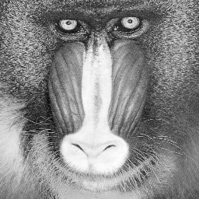
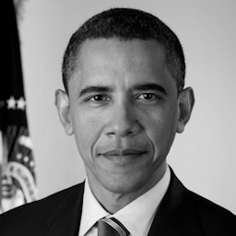
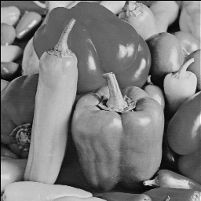
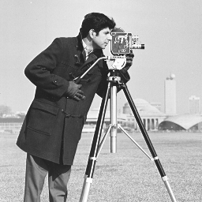
Input Images

Slide 20



Technique | Original Image | Modified Image | Parameters
Discrete Cosine Transform | Size=66094, E=6.6962 |  | SIZE=30396 MSE=8.8694E+003 RME=94.1777 SNR=14.0881 PSNR=19.9999 CR=2.1744 E= 6.4767
 | Size=66614, E=7.4462 |  | SIZE=42146 MSE= 3.0644E+004 RME= 175.0531 SNR= 14.2274 PSNR= 7.6018 CR=1.5806 E=7.3927
 | Size= 40181,E=7.5327 |  | SIZE=41876 MSE= 3.1846E+004 RME = 178.4534 SNR= 16.1651 PSNR= 7.2170 CR= 0.9595 E= 7.5044
 | Size= 32650,E=7.3529 |  | SIZE= 32608 MSE= 3.8623E+004 RME= 196.5264 SNR= 14.6069 PSNR= 5.2876 CR= 1.0013 E= 7.1938
 | Size= 66614,E=6.9046 |  | SIZE= 31390 MSE= 5.6845E+004 RME= 238.4209 SNR= 14.1735 PSNR= 1.4228 CR= 2.1221 E= 6.8272

Slide 21
Technique | Original Image | Modified Image | Parameters
Discrete Cosine Transform with Low Pass Filtering | Size=66094, E=6.6962 |  | SIZE=44116 MSE= 8.8002E+003 RME= 93.8095 SNR= 14.6278 PSNR= 20.0782 CR=1.4982 E=6.4606
 | Size=66614, E=7.4462 |  | SIZE= 51906 MSE= 3.0302E+004 RME= 174.0737 SNR= 14.7951 PSNR=7.7140 CR= 1.2834 E=7.3648
 | Size= 40181,E=7.5327 |  | SIZE= 41724 MSE= 3.1084E+004 RME= 176.3071 SNR= 15.3010 PSNR= 7.4590 CR= 0.7768 E= 7.4842
 | Size= 32650,E=7.3529 |  | SIZE= 42842 MSE= 3.8138E+004 RME= 195.2903 SNR= 14.9777 PSNR= 5.4138 CR= 0.7621 E= 7.3014
 | Size= 66614,E=6.9046 |  | SIZE= 40256 MSE= 5.5922E+004 RME= 236.4789 SNR= 14.8811 PSNR= 1.5864 CR=1.6548 E= 6.8453

Slide 22
Technique | Original Image | Modified Image | Parameters
Discrete Wavelet Transform | Size=66094, E=6.6962 |  | SIZE= 17462 MSE= 3.5987E+004 RME= 189.7021 SNR= 14.4215 PSNR= 5.9944 CR= 3.7850 E= 7.5690
 | Size=66614, E=7.4462 |  | SIZE= 17462 MSE= 8.5211E+004 RME= 291.9091 SNR= 14.4048 PSNR= -2.6253 CR= 3.8148 E= 4.6651
 | Size= 40181,E=7.5327 |  | SIZE= 17462 MSE= 8.2976E+004 RME= 288.0547 SNR= 16.2093 PSNR= -2.3595 CR= 2.3011 E= 5.0169
 | Size= 32650,E=7.3529 |  | SIZE= 17462 MSE= 7.6971E+004 RME= 277.4363 SNR= 14.8068 PSNR= -1.6083 CR= 1.8698 E= 4.1878
 | Size= 66614,E=6.9046 |  | SIZE= 17462 MSE= 9.1795E+004 RME= 302.9766 SNR= 14.4447 PSNR= -3.3696 CR= 3.8148 E= 2.7891

Slide 23
Technique | Original Image | Modified Image | Parameters
Discrete Wavelet Transform with Low Pass Filtering | Size=66094, E=6.6962 |  | SIZE= 17462 MSE= 3.5600E+004 RME= 188.6806 SNR= 14.3481 PSNR= 6.1024 CR= 3.7850 E= 7.4411
 | Size=66614, E=7.4462 |  | SIZE= 17462 MSE= 8.4572E+004 RME= 290.8130 SNR= 14.3641 PSNR= -2.5501 CR= 3.8148 E= 5.0856
 | Size= 40181,E=7.5327 |  | SIZE= 17462 MSE= 8.2279E+004 RME= 286.8435 SNR= 15.4348 PSNR= -2.2752 CR= 2.3011 E= 5.4129
 | Size= 32650,E=7.3529 |  | SIZE= 17462 MSE= 7.6129E+004 RME= 275.9149 SNR= 14.6125 PSNR= -1.4983 CR= 1.8698 E= 4.5747
 | Size= 66614,E=6.9046 |  | SIZE= 17462 MSE= 9.1215E+004 RME= 302.0182 SNR= 14.4277 PSNR= -3.3062 CR= 3.8148 E= 3.2753

Slide 24
Technique | Original Image | Modified Image | Parameters
Single Value Decomposition | Size=66094, E=6.6962 |  | SIZE= 66614 MSE= 9.1019E+003 RME= 95.4039 SNR= 14.3896 PSNR= 19.7412 CR= 0.9922 E=6.7141
 | Size=66614, E=7.4462 |  | SIZE= 66614 MSE= 3.0803E+004 RME= 175.5087 SNR= 14.5476 PSNR= 7.5498 CR=1 E=7.4747
 | Size= 40181,E=7.5327 |  | SIZE= 66614 MSE= 3.2019E+004 RME= 178.9376 SNR= 16.6040 PSNR= 7.1628 CR= 0.6032 E=7.5660
 | Size= 32650,E=7.3529 |  | SIZE= 66614 MSE= 3.8683E+004 RME= 196.6797 SNR= 14.6699 PSNR= 5.2720 CR= 0.4901 E=7.4644
 | Size= 66614,E=6.9046 |  | SIZE= 66614 MSE= 5.7009E+004 RME= 238.7652 SNR= 14.3831 PSNR= 1.3939 CR=1 E= 7.0599

Slide 25
Conclusion
Image Compression based on models of human perception, scalability, robustness, error resilience, and complexity are a few of the many challenges to be fully resolved and may affect image data compression performance in the years to come. Most image compression techniques achieve a high compression ratio. The tradeoff between data compression remains one of the difficult problems. Maintaining high compression ratios with good image quality is possible at a more or less high computational cost. One of the main goals for image data compression is to reduce redundancy in the image block as much as possible. That is, it is very important to represent an image with as few bits as possible while maintaining good image quality.

Slide 26
Conclusion
The various image compression techniques compared and contrasted here reveal that images can be substantially compressed as application demands. In an image as the redundant information gets added as more number of coefficients considered. This in turn increases the computational time along with storage space requirements. In image compression technique we expect the high compression ratio (CR) and also better quality of the reconstructed image. From the above results we conclude that as CR increases, value of PSNR decreases and RMSE increases. In DCT at high compression ratio quality of image degrades due to blocking artifacts. Hence at high compression ratio DWT technique is used which gives the better quality of the reconstructed image as compared to DCT. Also in DCT reconstructed image have the blurred but smoothened edges.

